Slide 2
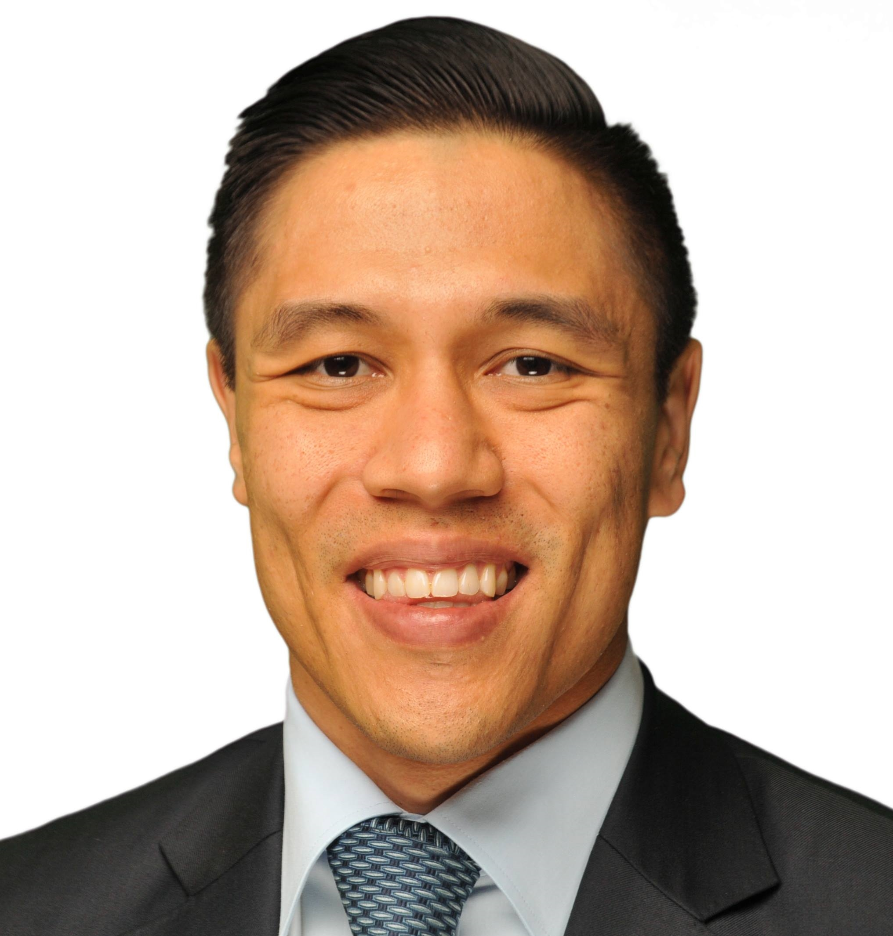
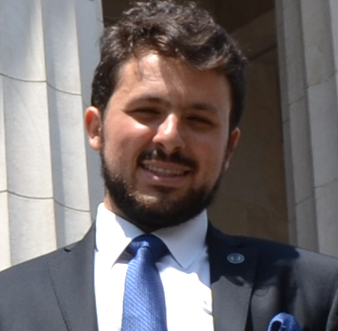


Team Introduction
Janul Hernandez
Diego Wolfsdorf
Anagha Todalbagi
Ryan Jang
NYU Stern MBA ‘17 Specialization: Data Science Contact Information: jh2609@stern.nyu.edu
Cornell Tech MEng ‘17 Specialization: [fill] Contact Information: daw284@cornell.edu
Cornell Meng IS ‘17 Specialization : [fill] Contact Information: at767@cornell.edu
NYU Stern MBA ‘17 Specialization: [fill] Contact Information: hrj26@cornell.edu

Slide 3
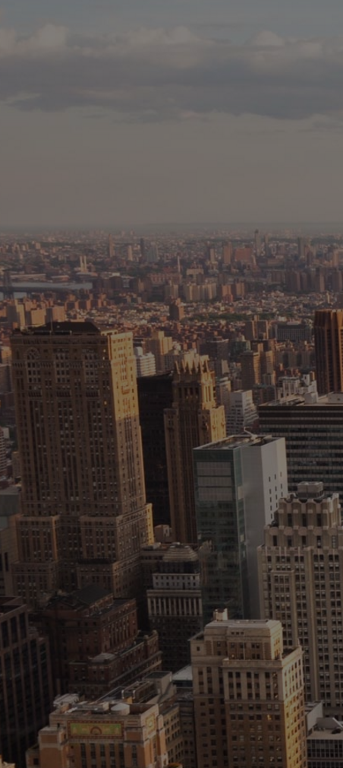
Table of Contents
Industry Dynamics
Current AML Problems
Our Solution
Demo
Challenges
Q&A

Slide 4


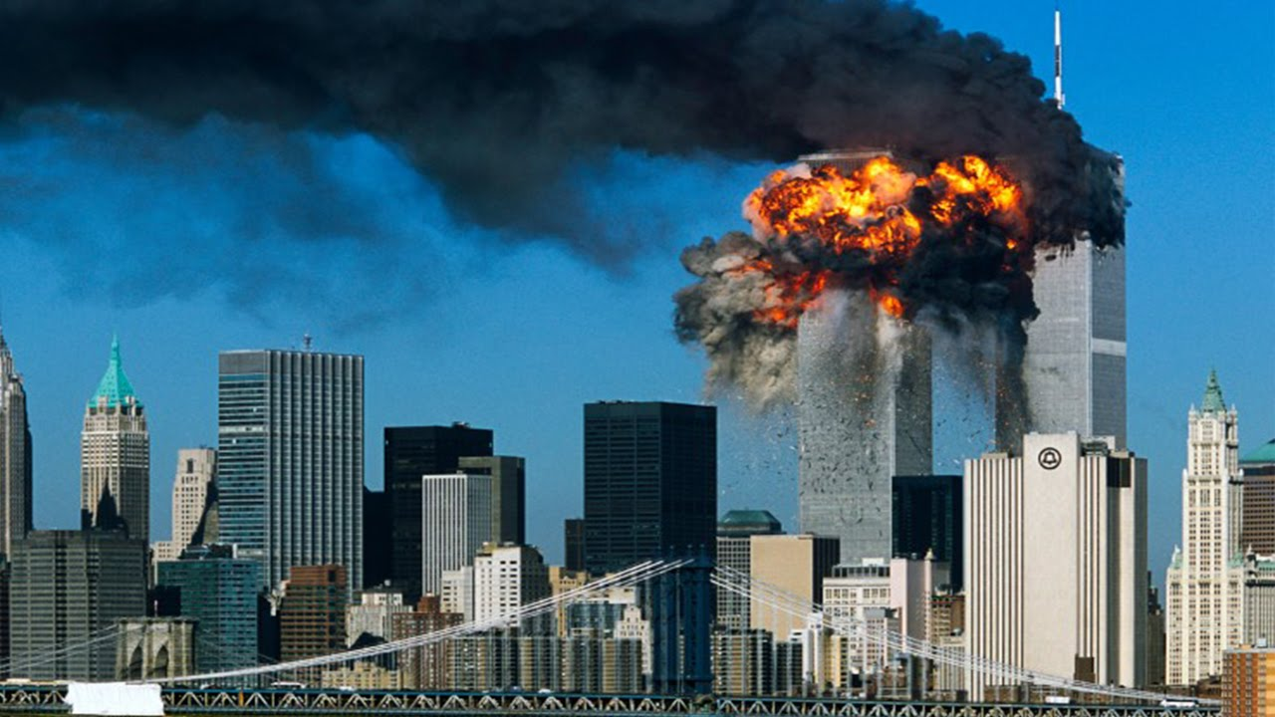
AML detection is a growing industry
$3.5 trillion passes through the market from money laundering annually - 80% of the world's illegal income.
Fraud Detection and Prevention market is expected to be $14 Billion in 2016 to $33 Billion by 2021, growing at 18%.

Slide 5
AML process is static and slow
Current anti-money laundering solutions are static with set scenarios and thresholds.
Current SARS reporting guidelines cast a wide net creating reports for innocent transactions leading to 9.4% refusal rates.
Machine Learning is being leveraged in credit risk analysis but not AML.

Slide 6
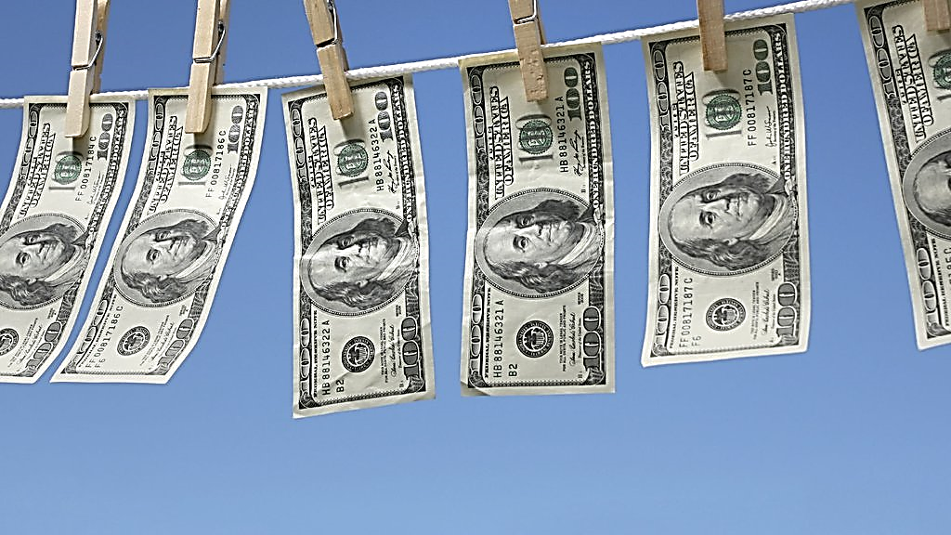
How might DUNS help institutional clients to detect money laundering more dynamically?

Slide 7
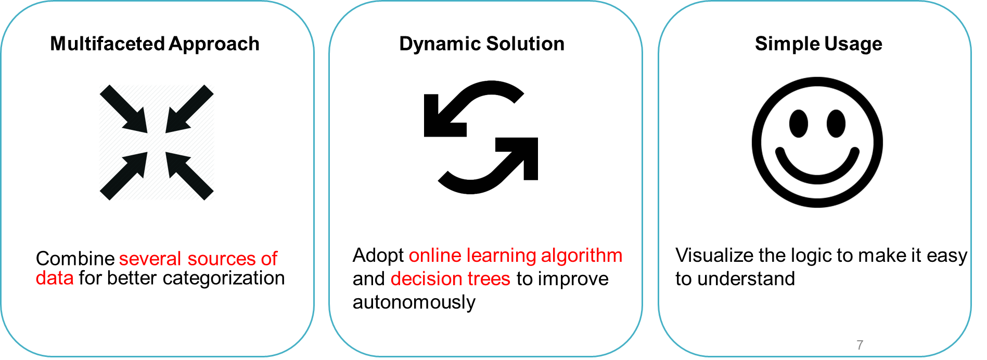
Project DUNS is your Data Science team

Slide 8
Case Study
Janul to update

Slide 9
Workflow
Janul to update

Slide 10
Proven Results
Janul to update

Slide 11
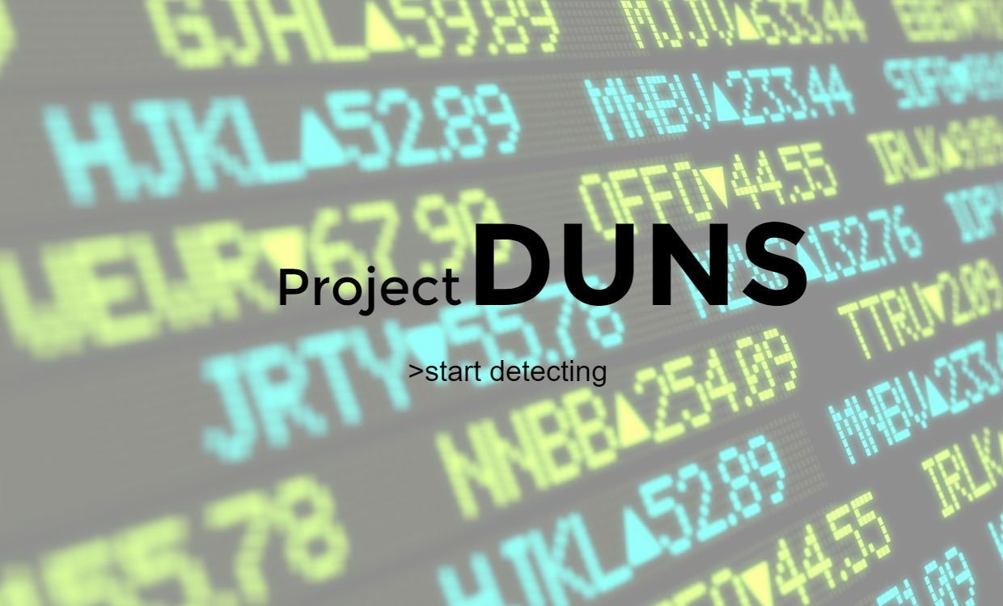

Slide 13



Multifaceted Approach
Dynamic Solution
Simple Usage
Adopt online learning algorithm and decision trees to improve autonomously
Visualize the logic to make it easy to understand
Combine several sources of data for better categorization

